Slide 1

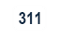
LA City 311
Yung-Wen Emily Liu
Clayton Tran
Leixi Yuan
Lulu Zhang

Slide 2
Agenda
Executive Summary
Los Angeles and 311
Overall Picture of Data
(December 2015 – November 2016)
Bulky Items
Homeless Encampment Issue
Conclusion

Slide 3
Executive Summary
Bulky Items
Homeless Encampment
Bulky Items are the most requested service in the current data set
Requests encompass all of Los Angeles
Homeless Encampment have the longest average processing time in the current data set
Upward trend of requests
Need to ensure performance metrics can be met with the sheer amount of demand
Growing number of requests are indicative of homeless issue as well as resident displeasure
Notes:
Need to do executive summary

Slide 4
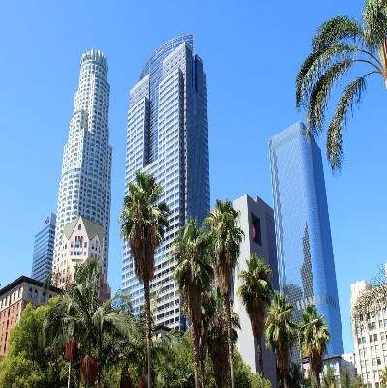

Analyzing trends in 311 requests can reveal insights and demands of Los Angeles inhabitants
Los Angeles
311
Population of 9.8 M
Large sprawl – 4.7K sq miles
Traffic, beautiful weather, diverse communities
Allows anyone in Los Angeles to request services
Phone, email, or mobile app
Requests include removing bulky item and reporting water waste
Why?
Understanding trends of 311 requests can reveal insights about the inhabitants of Los Angeles and their unique needs as well as the conditions of the city

Slide 5
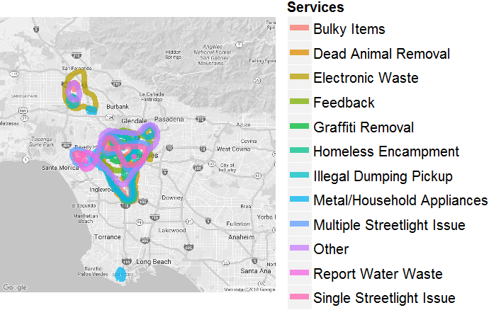
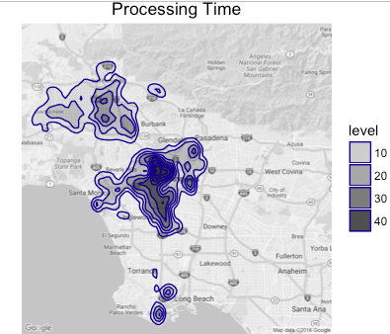
311 provides a wide range of services throughout Los Angeles, Long Beach, and the Valley
Services are primarily centered in Downtown, Hollywood, and South LA with some activity in the Valley; Downtown processing time appears to be longer.
Notes:
What does the levels of processing time mean?

Slide 6
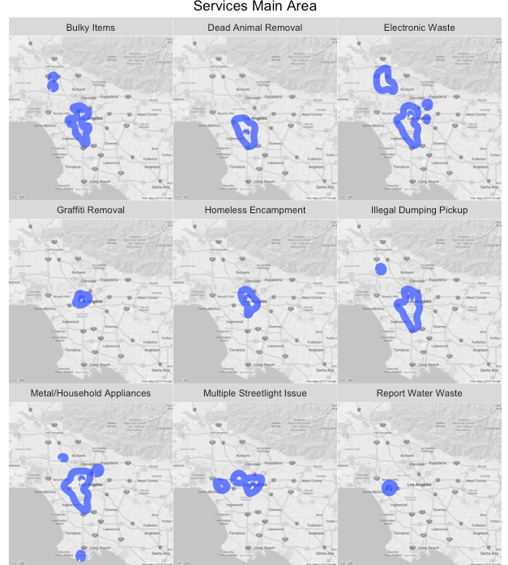
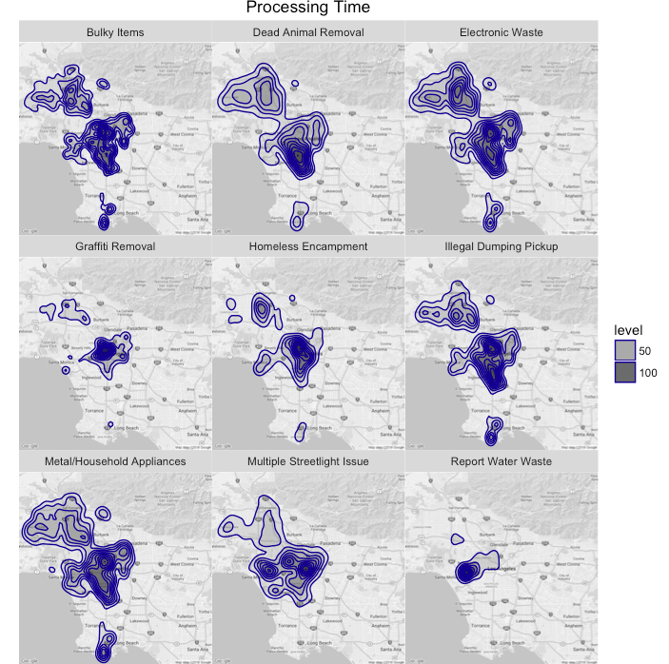
Certain services are delivered throughout Los Angeles, while others are isolated to one area
Processing time can range broadly despite frequency of service areas is central to specific areas

Slide 7
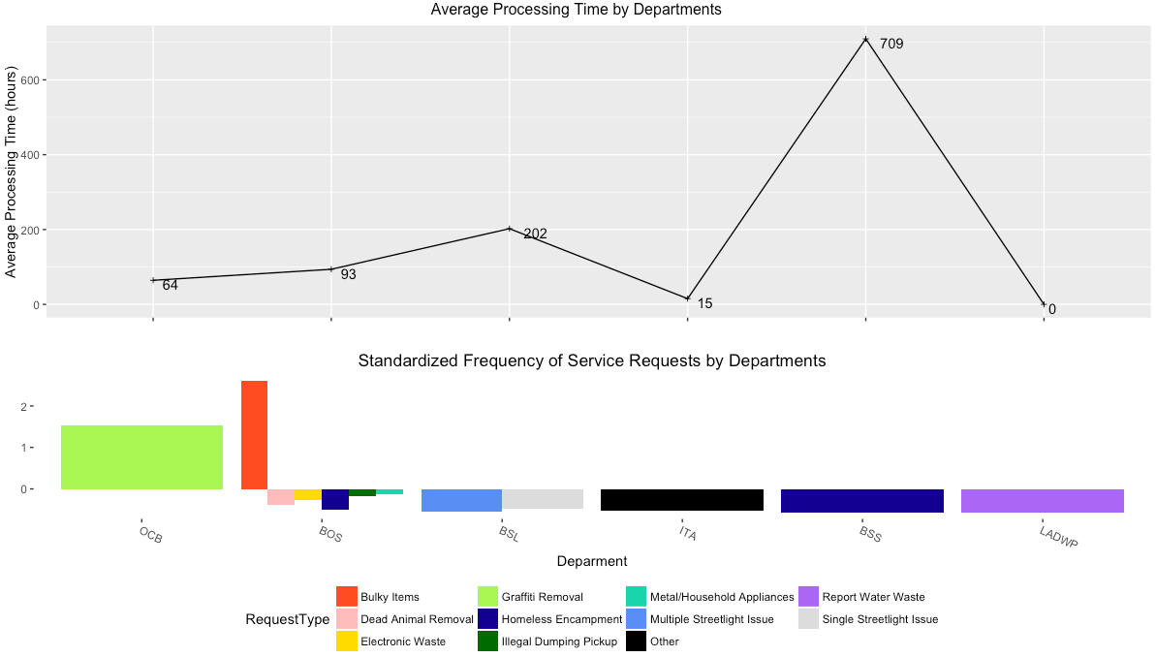
Bulky items and homeless encampment are two areas of interest in this dataset
Notes:
Bulky items had the highest frequency of calls in this dataset
While Homeless had the longest to process

Slide 8
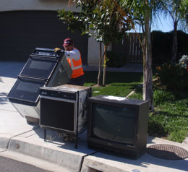
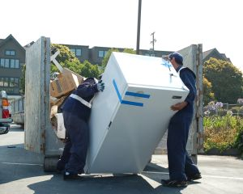
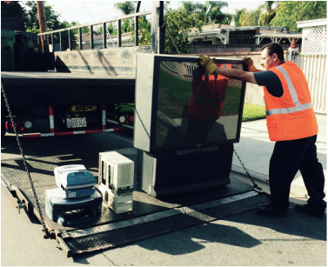
Bulky item services are necessary for safety, sanitation, and convenience
Report illegally dumped items or discard old sofas, refrigerators, mattresses, and other large household items
Managed primarily by the Bureau of Sanitation (BOS) with some support by the Bureau of Street Services (BSS)
Notes:
http://www.paulkrekorian.org/call_311_for_bulky_item_pickup
call 311 at least one day before your regular trash collection day and the Bureau of Sanitation will remove the items for free

Slide 9
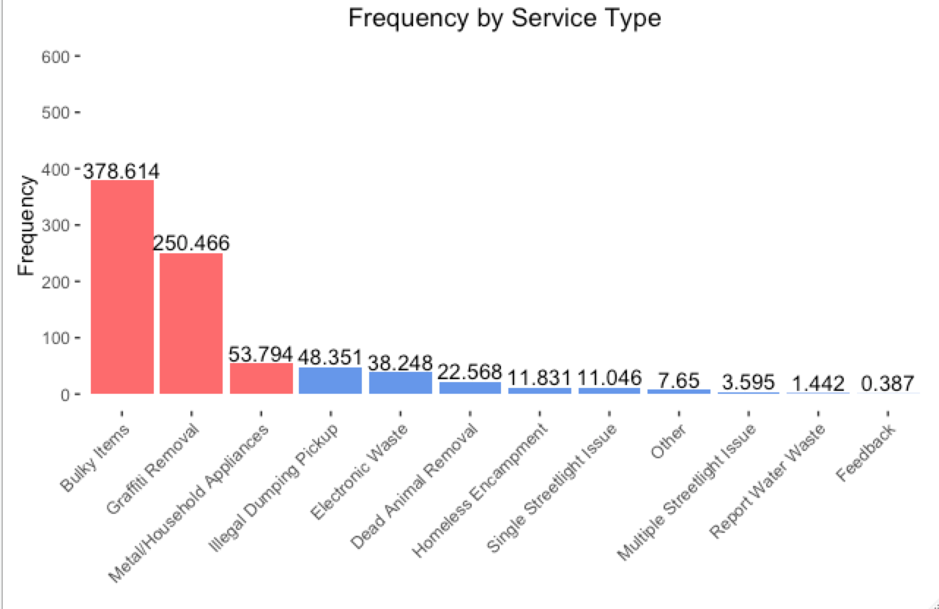
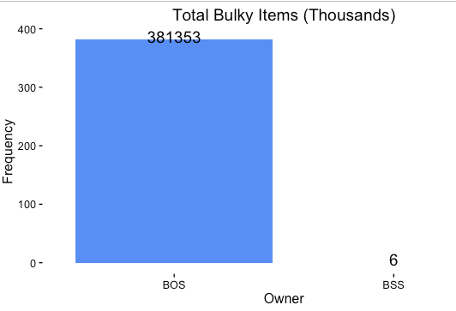
Bulky item requests comprise of the majority of requests for 311
Bulky Items are 44% of all total 311 requests
Bureau of Sanitation (BOS) handles 99.9% of Bulky Item Requests

Slide 10
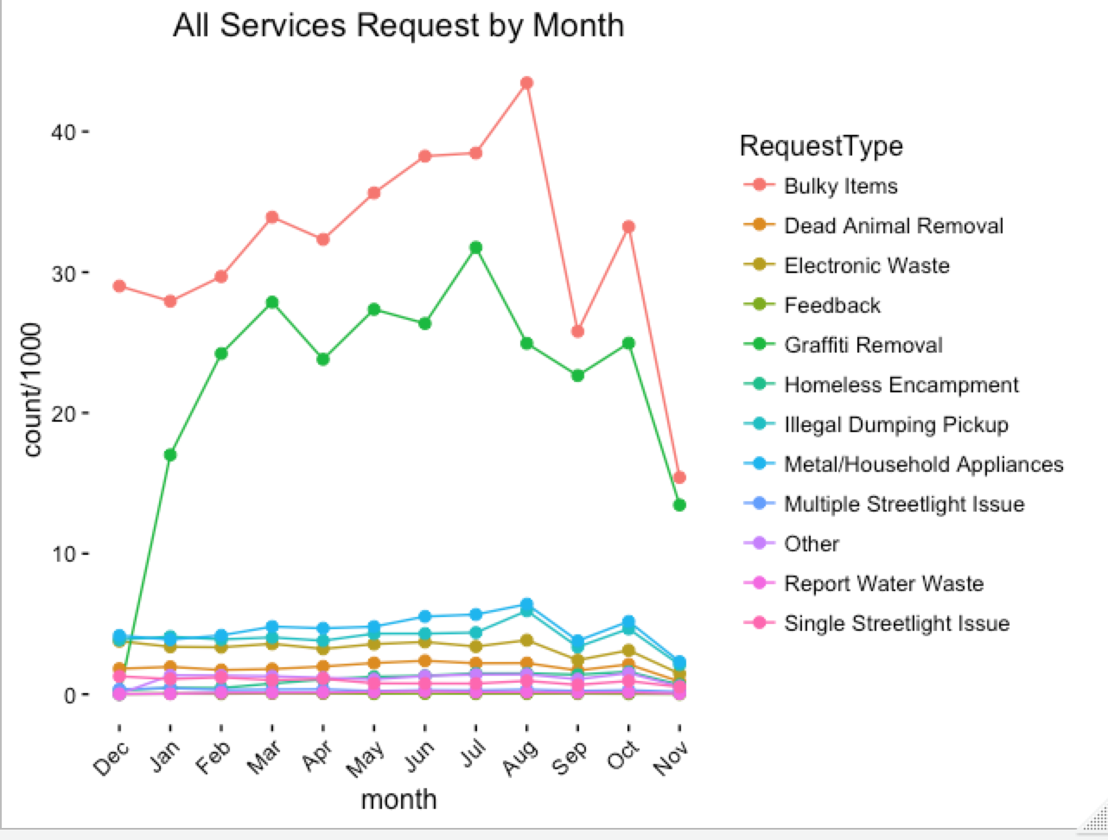
Bulky item requests hit a peak in August and declines dramatically in the following months
Potential reasons include
Prime moving season extends from June to September
Families moving for children’s educational reasons such as transferring to a new school or beginning college
Big closeout sales for furniture begin in July as new styles are introduced in August

Slide 11
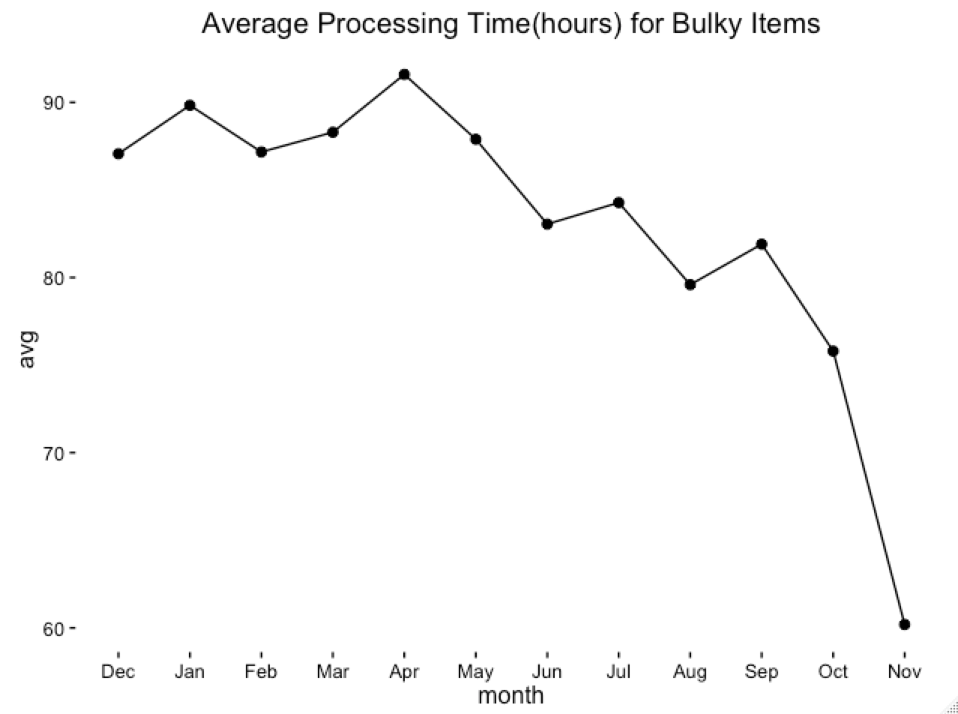
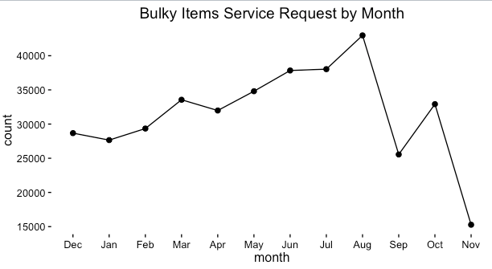
Peak processing time for bulky items is in April
Although the expectation that average processing time should either increase as frequency of requests increases or ideally stay the same despite the frequency of requests, that is not the case for this dataset
*November Processing time is at 0 because no jobs have yet been completed

Slide 12
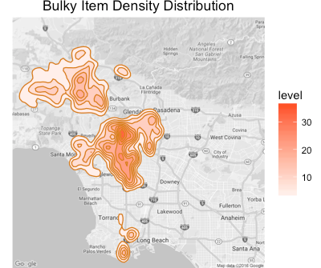
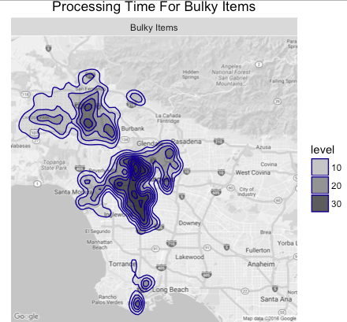
Bulky item requests range throughout Southern California
Highest Processing Time appears to be in Central LA

Slide 13
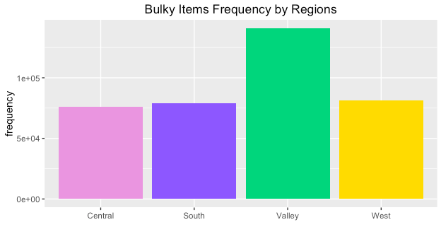
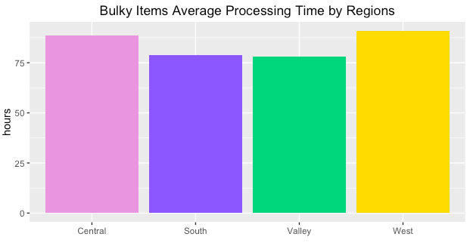
Bulky item requests occur primarily in the Valley based on police precinct
Valley represents the majority of Bulky Item requests
Average processing time across the four regions is largely consistent
Notes:
Average Processing time is 83 Hours

Slide 14
City of LA should staff to meet demand and to maintain processing time for bulky items
Insight from data
Next steps
Bulky item requests see a significant increase during August
Bulky item average processing time sees its peak during April
Identify potential external reasons for this pattern
Does April have adequate staffing to fulfill these requests?
Was August overstaffed to fulfill the expected increased demand?
Perform customer satisfaction analysis on the length of average processing time
Consider looking into proactive measures to further decrease processing time

Slide 15
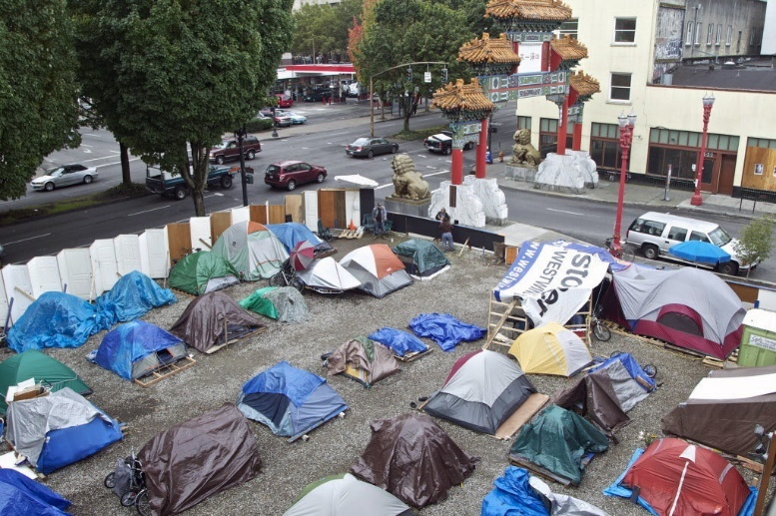
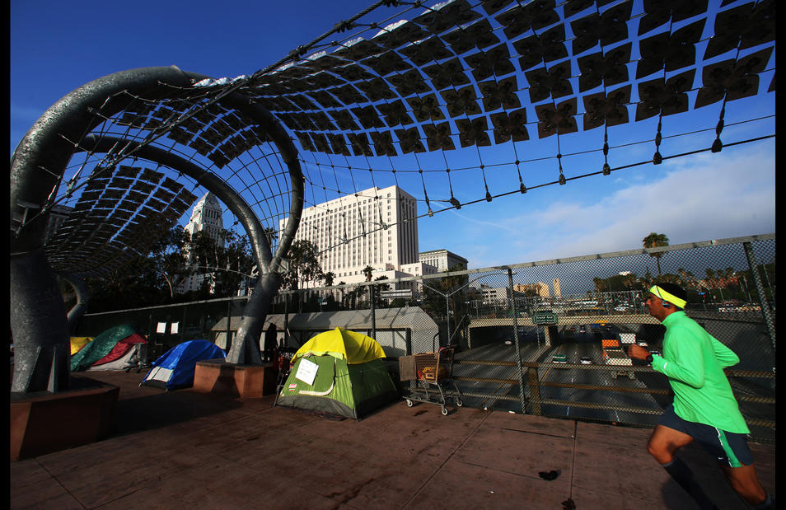
The homeless situation in Los Angeles is a crisis; 311 requests seek to clean up LA’s image
In the City of Los Angeles, there are over 25,000 homeless people, with over 10,000 living in Downtown LA; most recently it jumped 12% in the last two years
Service requests prompt the city to investigate the proposed area and conduct sweeps to remove the homeless from their camping spots
All individuals in the clean-up area will be given up to 15 minutes to take their personal property and vacate the area. City of LA will provide services to help transition them to other shelters
Notes:
http://clkrep.lacity.org/onlinedocs/2014/14-1656-S1_misc_03-22-2016.pdf
https://myla311.lacity.org/portal/faces/home/directory/categories?filterBy=Public+Infrastructure+%26+Landscape%3A+Streets&_afrLoop=7710611408168751&_afrWindowMode=0&_afrWindowId=null#%40%3F_afrWindowId%3Dnull%26_afrLoop%3D7710611408168751%26filterBy%3DPublic%2BInfrastructure%2B%2526%2BLandscape%253A%2BStreets%26_afrWindowMode%3D0%26_adf.ctrl-state%3Dp27mgbuvq_89
http://www.citywatchla.com/index.php/the-la-beat/10661-mind-blowing-facts-about-la-s-homeless-people-and-how-to-un-homeless-them

Slide 16
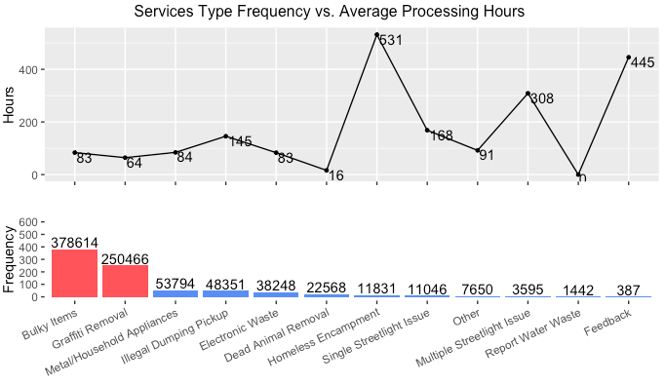
Homeless encampment requests take the longest to process yet is one of the least requested
Possible reasons include:
Joint cooperation between city sanitation workers and LAPD
Competing, higher priority tasks by the LAPD
Sweeps without potential housing solutions in place
Notes:
Need to update this graph
http://www.latimes.com/local/lanow/la-me-ln-l-a-homeless-sweep-freeway-overpass-20160315-story.html

Slide 17
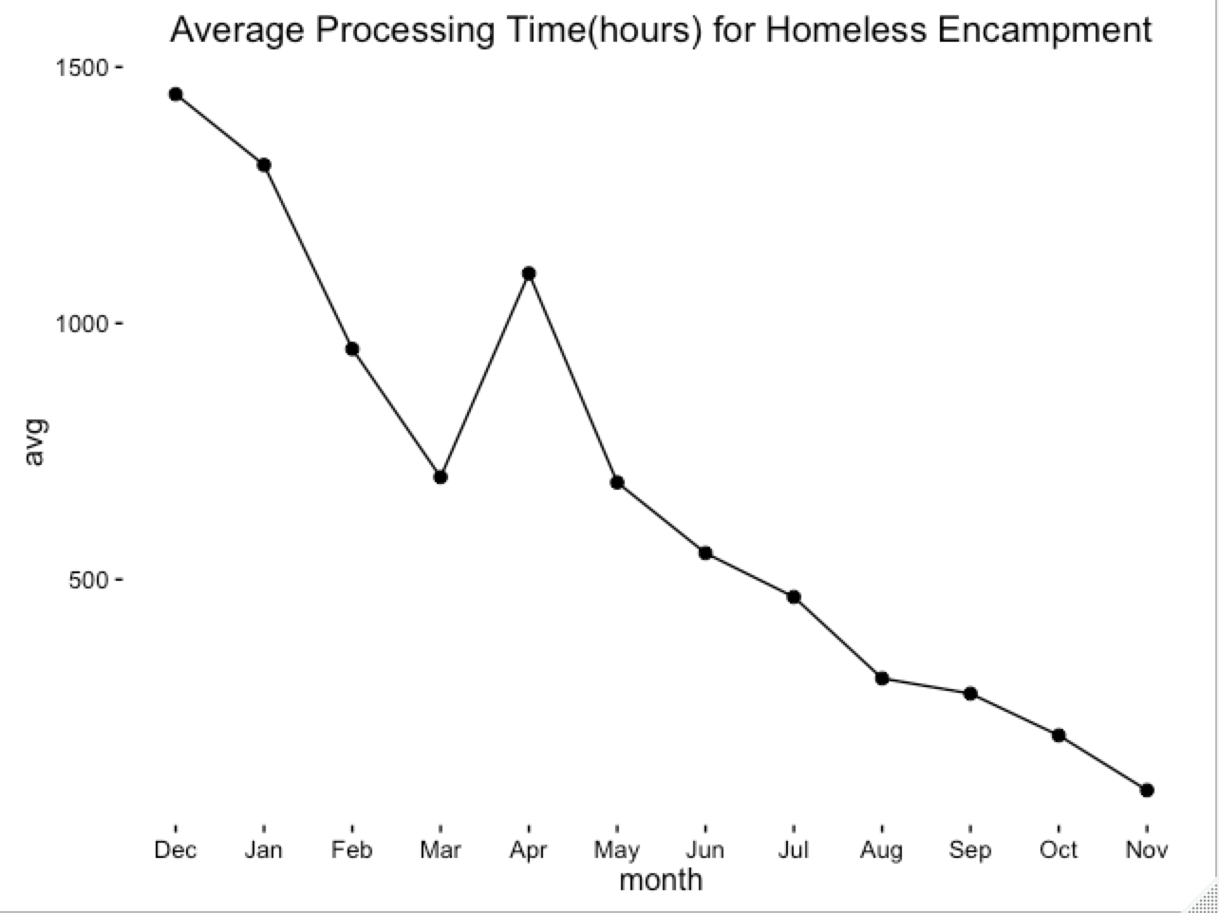
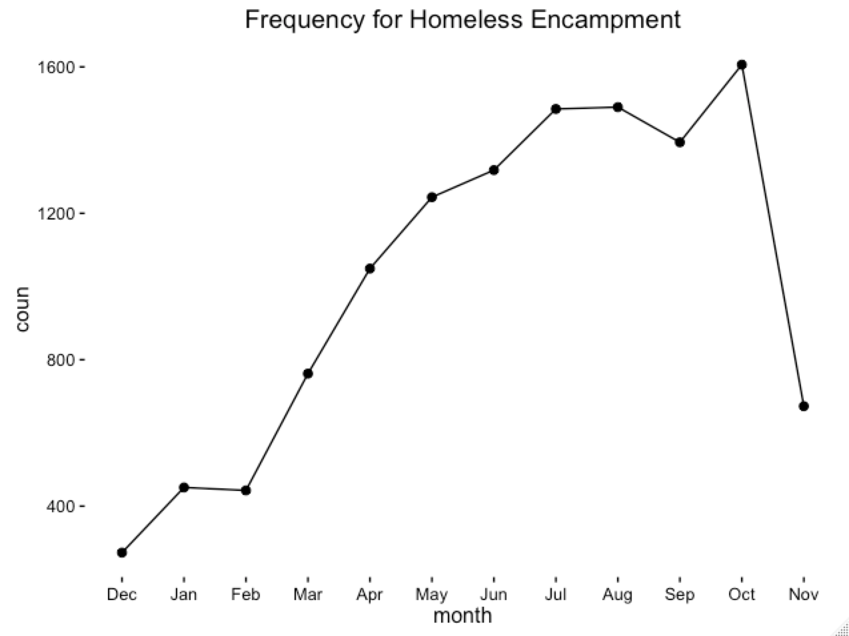
Average processing time decreased as the frequency of homeless requests increased
Decreasing average processing time is promising but increasing frequency of requests is alarming
*November Processing time is at 0 because no jobs have yet been completed

Slide 18
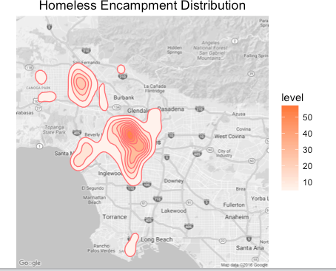
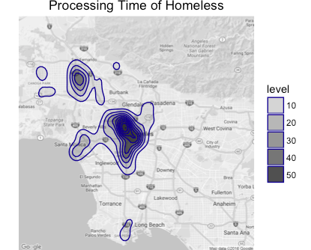
Homeless encampment is centered in Downtown Los Angeles with some activity in the Valley
Average processing time is at the highest in Downtown Los Angeles

Slide 19
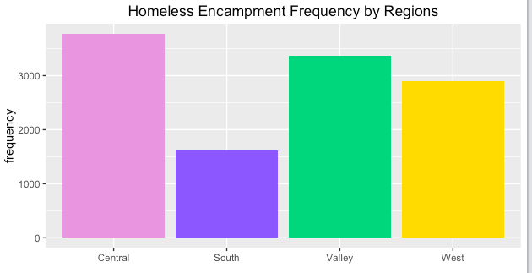
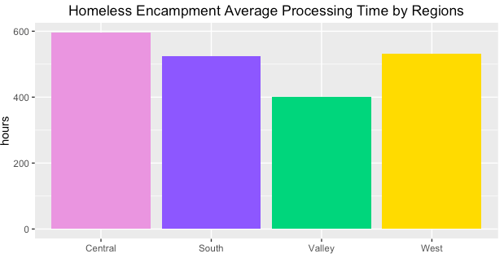
Homeless encampment occur primarily in central LA based on police precinct
There is a performance gap in the South and West Regions – low frequency but high average processing time
The Valley is performing well – second highest frequency but low average processing time
Notes:
What is the average processing time for homeless encampment
Average Process Time is 531 Hours

Slide 20
City of LA should adopt best practices from the Valley to offset rising trend of requests
Insight from data
Next steps
Although there is a downward trend in average processing time, there is a positive trend for number of requests is alarming.
The Valley has a prominent number of requests but on average has better average processing time than other regions.
Identify potential reasons for this pattern
Need appropriate resources to respond to these service requests – number of stakeholders involved
Downstream issues regarding what to do with homeless after “sweeps”
Consider high number of requests are customer complaints about LA living environment
Identify homeless hot spots to target homeless shelters
Notes:
Need to update recommendation for Homeless

Slide 21
Summary of Insights
Bulky Items
Largest proportion of 311 calls
Homeless Encampments
Highest average processing time
Need to ensure performance metrics can be met because of the sheer number of requests
Although performance is promising, upward trend is alarming
Assess if customers are satisfied with processing time
Find areas to target homeless shelters

Slide 22
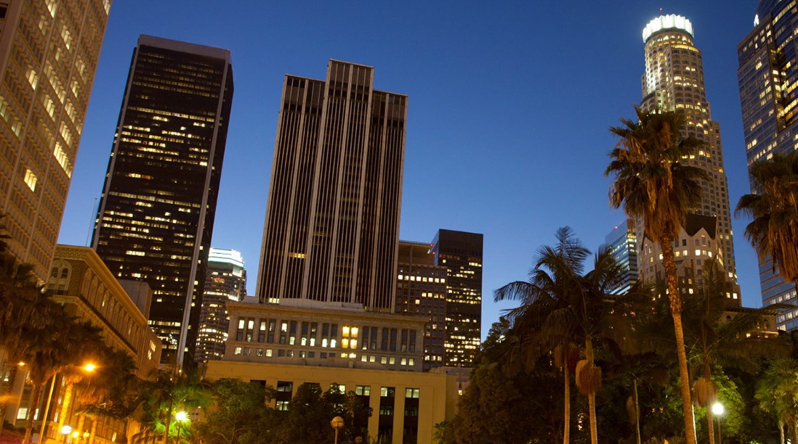
Questions?

Slide 23
Appendix

Slide 24
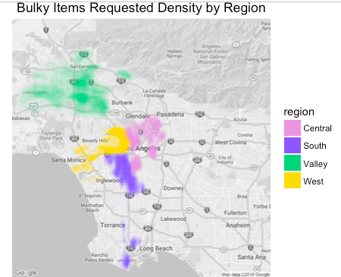
Sample of Regions

Slide 25
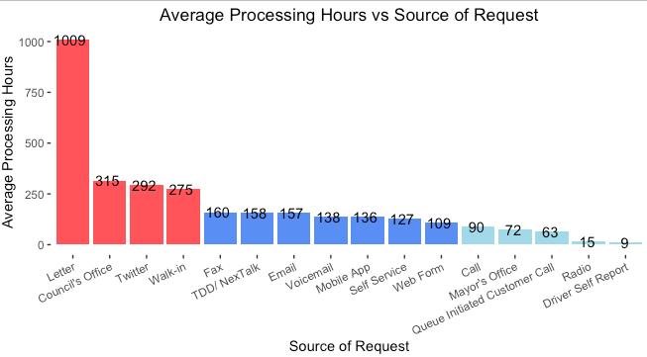
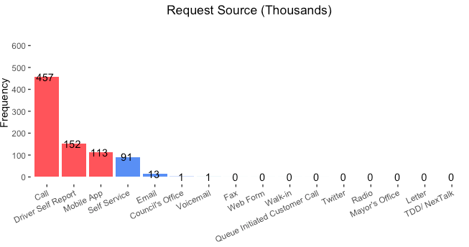
Mobile requests were the top 3 most frequent request sources

Slide 26
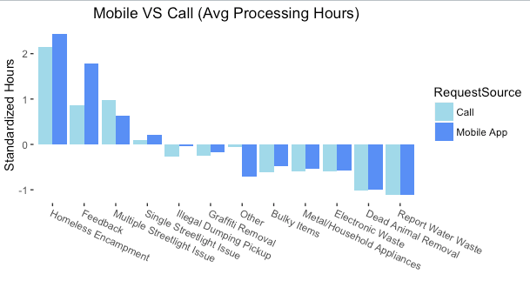
Mobile apps and Call Comparison

Slide 27
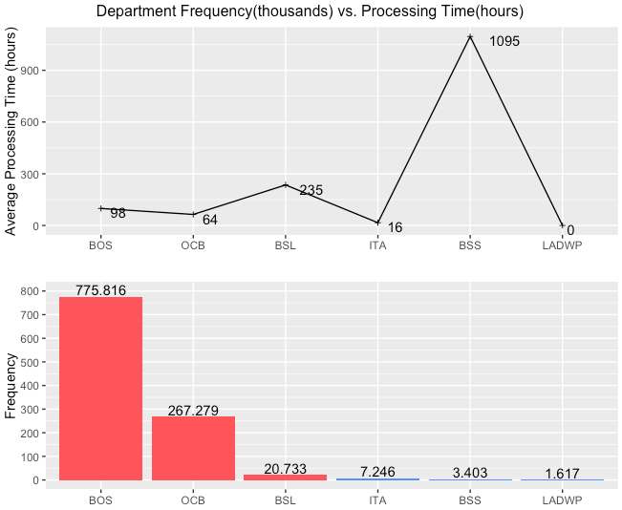
Bureau of Sanitation
Bureau of Sanitation performing well considering the number of requests they get
BSS is not performing well considering the lack of number of requests they get

Slide 28
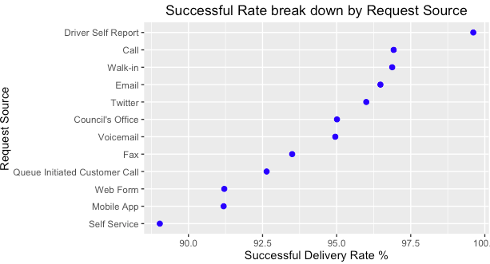
Service requests have nearly above 90% success rates

Slide 29
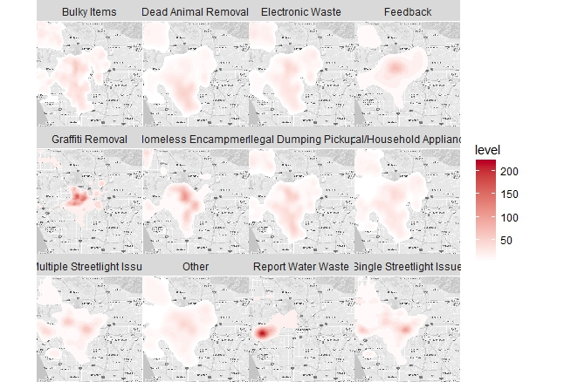
Services requests differ based on region – water waste is primarily located near Santa Monica
Water waste near the coast
Graffiti removal centered around Central LA and Hollywood areas
Most service types were represented fairly the same

Slide 30
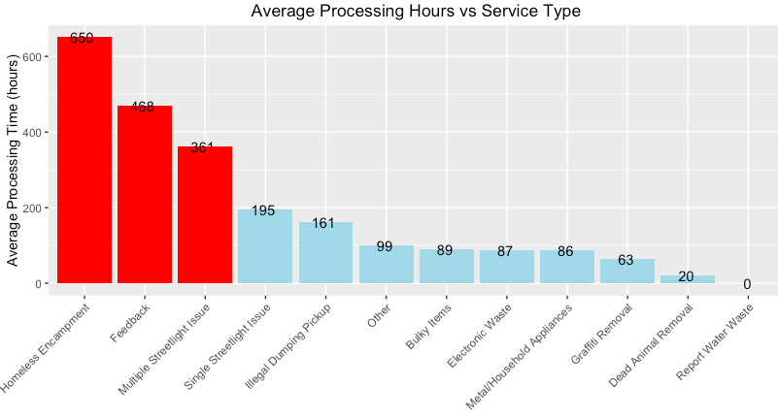
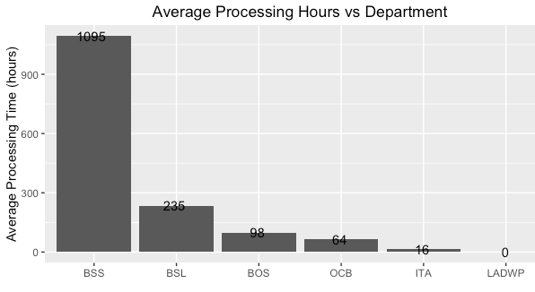
BSS has the worst average processing time

Slide 31
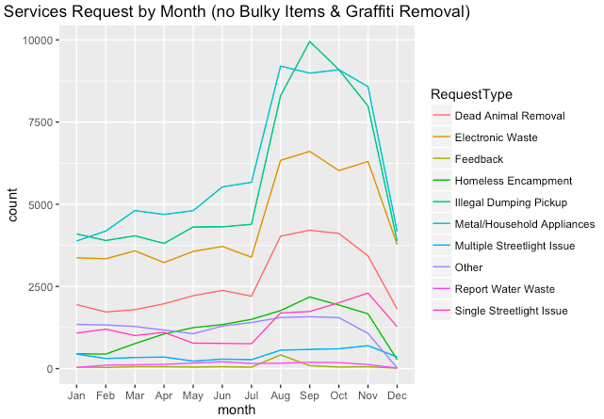
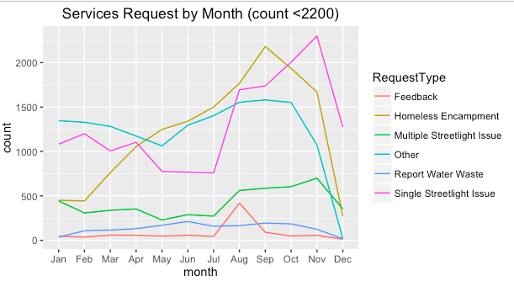
Frequency tables based on service request

Slide 32
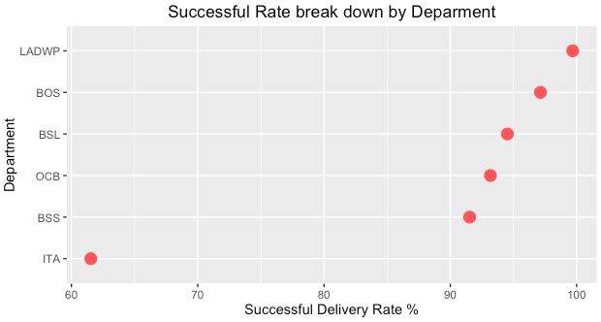
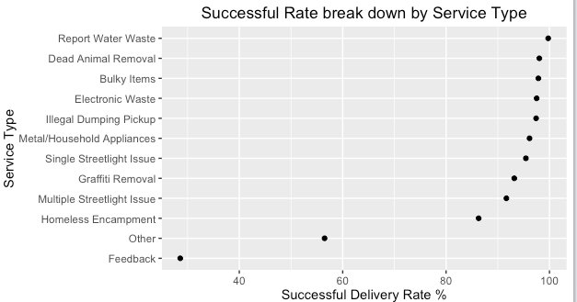
Success rates of Request Sources, Department, and Service Type

Slide 33
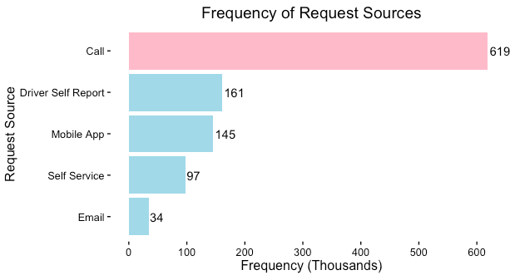
Frequency of Request Sources

Slide 34
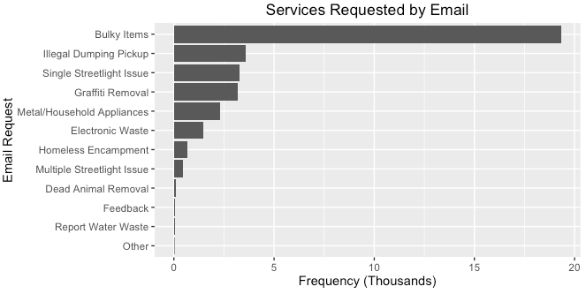
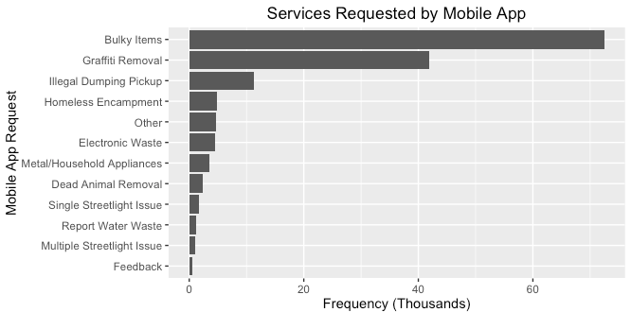
Services Request by Email and Mobile App

Slide 35
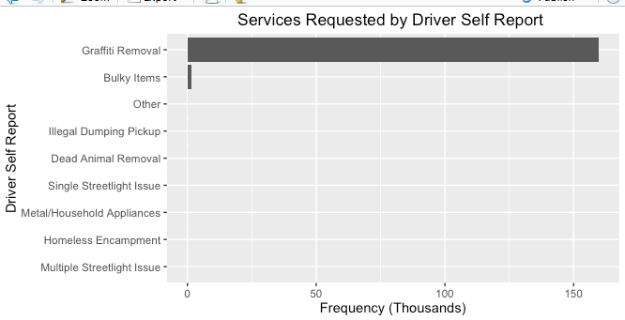
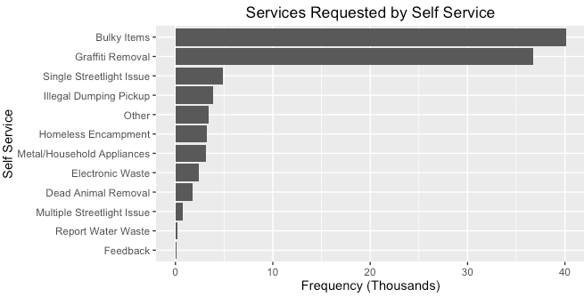
Services Requested by Driver Self Report and Self Service

Slide 36
Services Requested by Driver Self Report

Slide 37
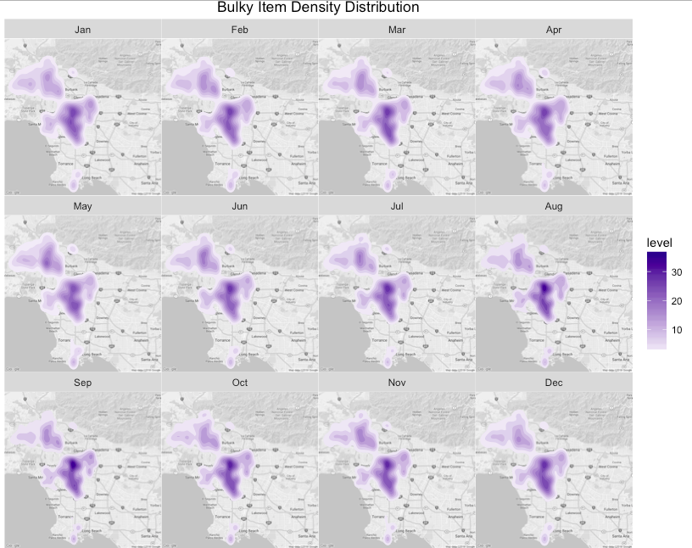
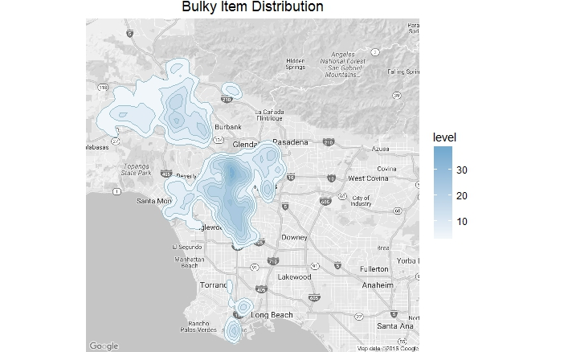
Bulky item requests are primarily centered in Hollywood, Central LA, and South LA
Notes:
Look at requests in Region between July and September

Slide 38
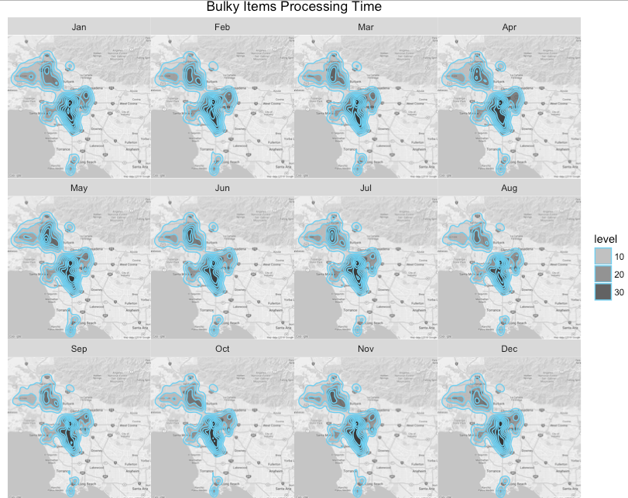
No significant difference across regions for processing time for bulky item requests

